Slide 1
Augmenting data structures
Data structures

Slide 2
Augmenting data structures
Instead of working from scratch the implementation of a custom data structure we use the one that most adapts to our needs and based on it start building on it its called data structure augmentation.

Slide 3
How to augment a data structure
Methodology
Choose an underlying data structure.
Determine additional information to maintain in the underlying data structure.
Verify that we can maintain the additional information for the basic modifying operations on the underlying data structure.
Develop new operations.

Slide 4
Data structures to review
In book for data structure augmentation
Dynamic Ordered Statistics
Red-Black Tree

Slide 5
Augmenting Red-black tree
We can maintain the size attribute for Red Black Tree.

Slide 6
Binary search trees
Ordered or sorted, binary trees
Nodes can have 2 subtrees
Items to the left of a given node are smaller
Items to the right of a given node are larger

Slide 7
Bst - Problems
6
6
2
4
8
null
4
3
7
9
3
1

Slide 8
Balanced search trees
Guaranteed height of O(log n) for n items.

Slide 9
Red-Black tree
A Node is either red or black
The root and leaves (NIL) are black
If a node is red, then its children are black
All Paths from a node to its NIL descendants contain the same number of black nodes.

Slide 10
8
5
15
nil
nil
12
19
9
13
23
nil
nil
nil
nil
nil
nil
nil

Slide 11
Operations
Search
Insert (Require rotation)
Remove (Require rotation)

Slide 12
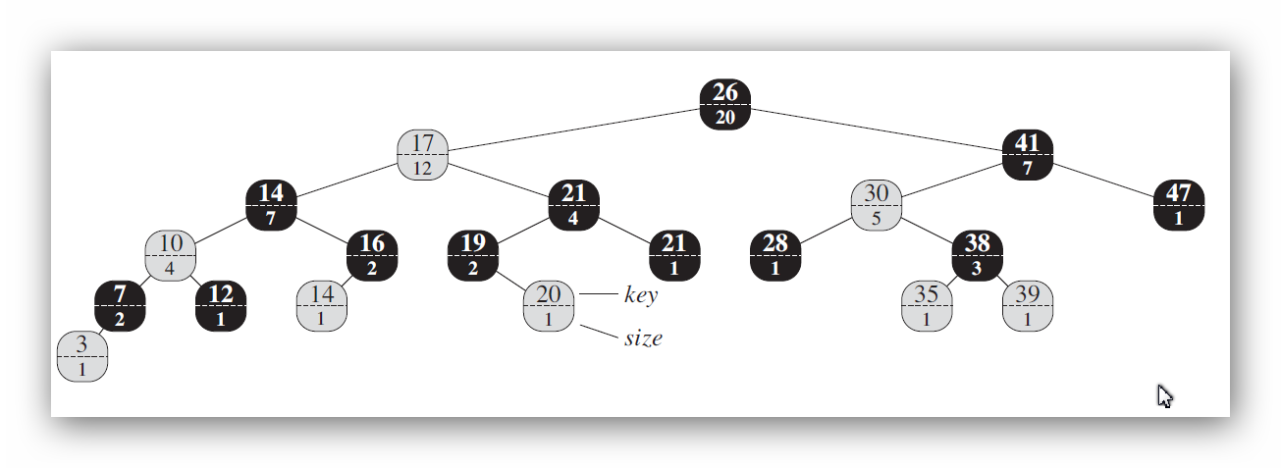
OST – Red Black Tree

Slide 13
Retrieving an element with a given rank
OS-SELECT(x; i )
1 r = x.left.size + 1
2 if i == r
3 return x
4 elseif i < r
5 return OS-SELECT(x.left; i)
6 else return OS-SELECT(x.right; i – r)

Slide 14
Determining the rank of an element
OS-RANK(T; x)
1 r = x.left.size +1
2 y = x
3 while y != T.root
4 if y == y.p.right
5 r = r + y.p.left.size + 1
6 y = y.p
7 return r

